Slide 1

KAKATIYA INSTITUTE OF TECHNOLOGY AND
SCIENCE,WARANGAL-15
DEPARTMENT OF INFORMATION TECHNOLOGY
Major Project Presentation
on
TWITTER SENTIMENT ANALYSIS FOR
HEALTH CARE MANAGEMENT
By
N.Raswitha(B15IT053)
Saba Shireen(B15IT046)
V.Abhigna(B15IT012)
Major Project Supervisor:-
Dr.P.Kamakshi
Professor & Head
Dept.of IT
Head:-
Dr.P.Kamakshi
Professor & Head
Dept.of IT

Slide 2
Introduction
Healthcare is a data-rich industry. Big data is fast, expanding rapidly and is highly varied. Twitter can serve as an important data source for providing real-time information that has stimulated companies in diverse domains to understand their consumers. In the healthcare field we will concentrate on patients, the illness they were suffering from, the hospital they preferred at the time of sickness, service provided to them and were they satisfied or not. The era of social media generates an enormous amount of data for analysis. The outcome information is beneficial for the health of individuals. Analyzed information is further used for the recommendation of hospitals at the time of ailment. Health care is still a nascent field undergoing rapid change and evolution due to continuous enhancements in medicine. It is based on the opinion and satisfaction rate of the patients. This work is conducted through an online survey and then based on the satisfaction rate, the hospitals are selected. The messages posted in Twitter called tweets are used for comparison of the sentiments of the patients that are correlated to the hospitals selected. The comparison shows the popularity of a hospital among patients at the time of ailment.

Slide 3
Natural Language Tool Kit(NLTK) :
The NLTK module is a massive tool kit, aimed at helping you with the entire Natural Language Processing (NLP) methodology. NLTK will aid you with everything from splitting sentences from paragraphs, splitting up words, recognizing the part of speech of those words, highlighting the main subjects, and then even with helping your machine to understand what the text is all about.
The idea of Natural Language Processing is to do some form of analysis, or processing, where the machine can understand, at least to some level, what the text means, says, or implies.

Slide 4
Description of Algorithm and Modules
Naive Bayes Classifier :
This is a pretty popular algorithm used in text classification, so it is only fitting that we try it out first. Before we can train and test our algorithm, however, we need to go ahead and split up the data into a training set and a testing set.
This is called supervised machine learning, because we're showing the machine data, and telling it "hey, this data is positive," or "this data is negative." Then, after that training is done, we show the machine some new data and ask the computer, based on what we taught the computer before, what the computer thinks the category of the new data is.

Slide 5
Sentiment Analysis Module :
Sentiment Analysis is the process of ‘computationally’ determining whether a piece of writing is positive, negative or neutral. It’s also known as opinion mining, deriving the opinion or attitude of a speaker.
In this module the sentiment analysis is done on the data(i.e twitter tweets) which is collected from the input given by the user and it will able to identify whether the given sentence is neagtive or positive by using natural language tool kit and able to produce whether it is positive or negative.

Slide 6
The list of the classifiers which we use:
1. Multinomial Naive Bayes classifier:
The multinomial Naive Bayes classifier is suitable for classification with discrete features (e.g., word counts for text classification). The multinomial distribution normally requires integer feature counts.
2. Bernoulli Naive Bayes classifier:
The Bernoulli naive Bayes classifier assumes that all our features are binary such that they take only two values (e.g. a nominal categorical feature that has been one-hot encoded).
3.Logistic Regression classifier:
Logistic regression is a regression algorithm and it does predict a continuous outcome: the probability of an event. That we use it as a binary classifier is due to the interpretation of the outcome.

Slide 7
5.SGDClassifier:
SGDClassifier is a linear classifier (by default in sklearn it is a linear SVM) that uses SGD for training (that is, looking for the minima of the loss using SGD).
6.Linear SVC_Classifier:
Linear SVC (Support Vector Classifier) is used to fit to the data you provide, returning a "best fit" hyperplane that divides, or categorizes, your data.

Slide 8
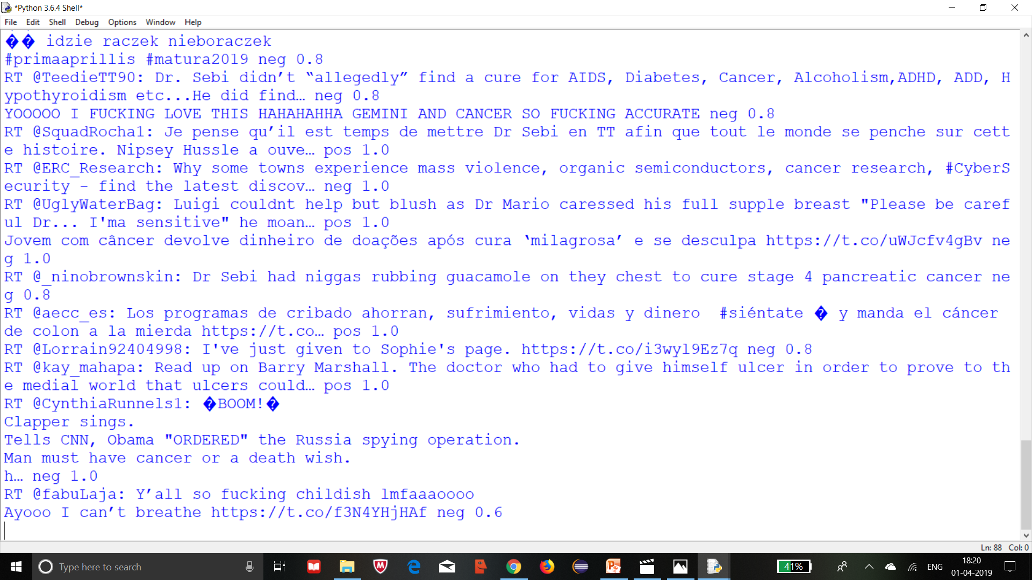
Output
Output of the tweets after doing sentiment analysis on ‘cancer’ word tweets:

Slide 9
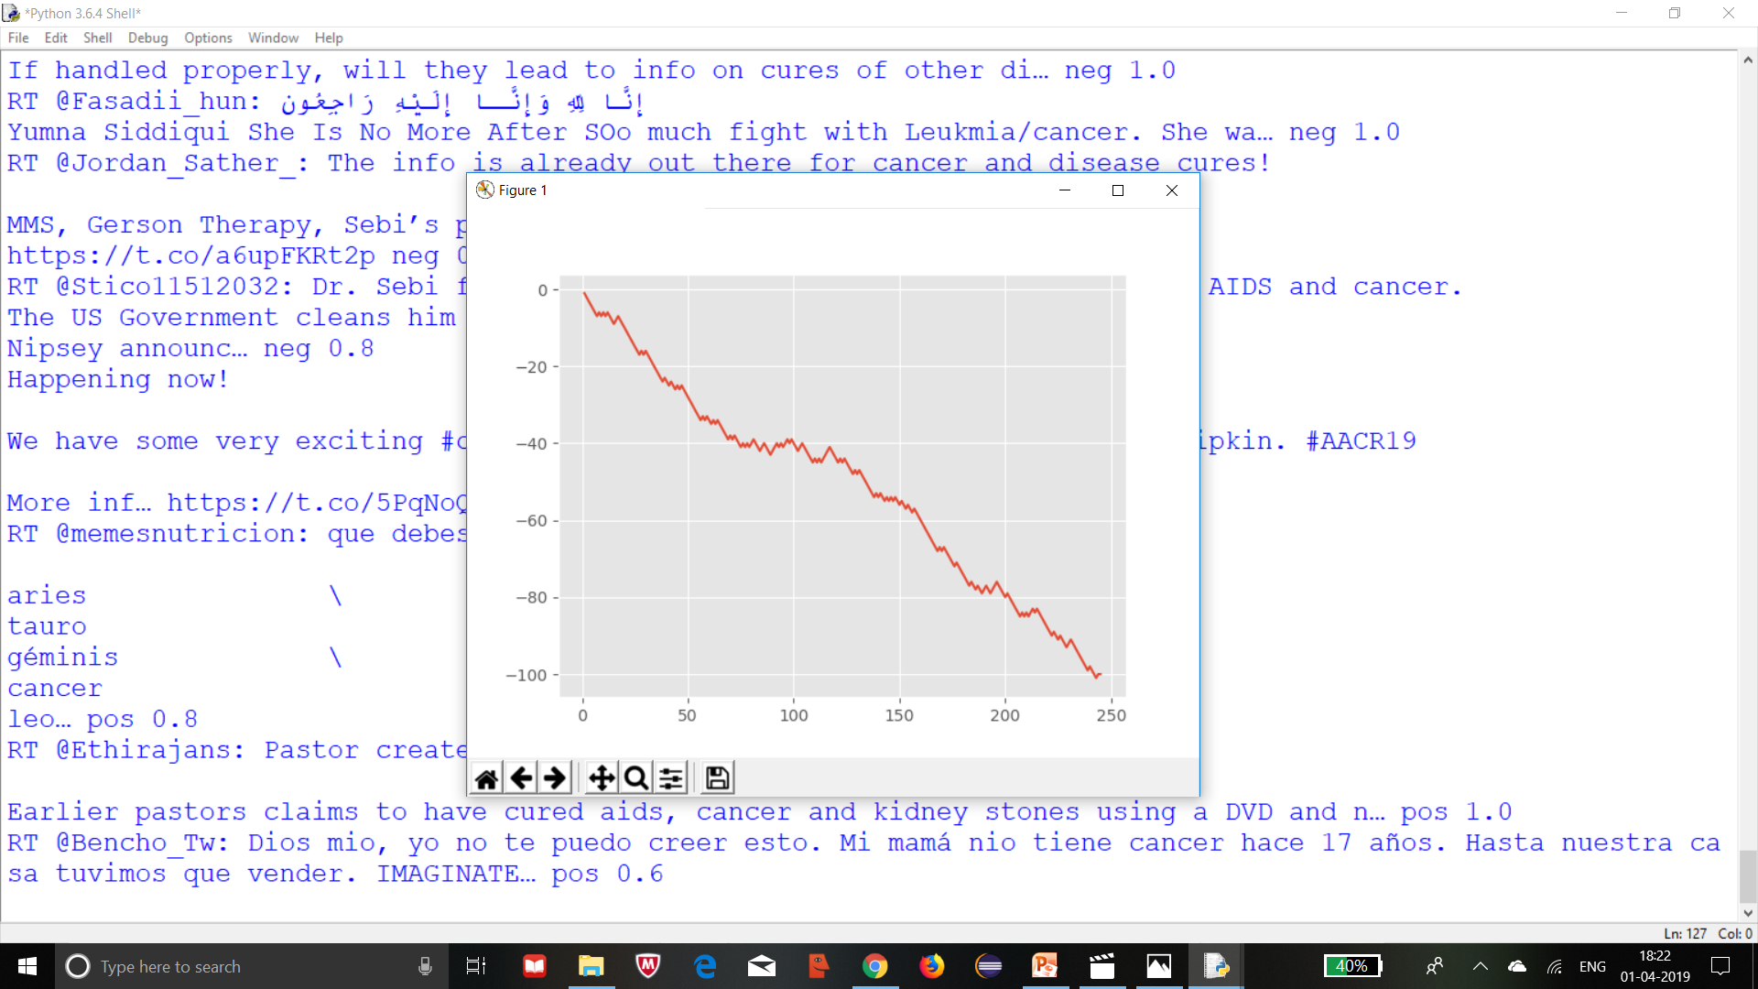
Graph of live Streaming twitter data:

Slide 10
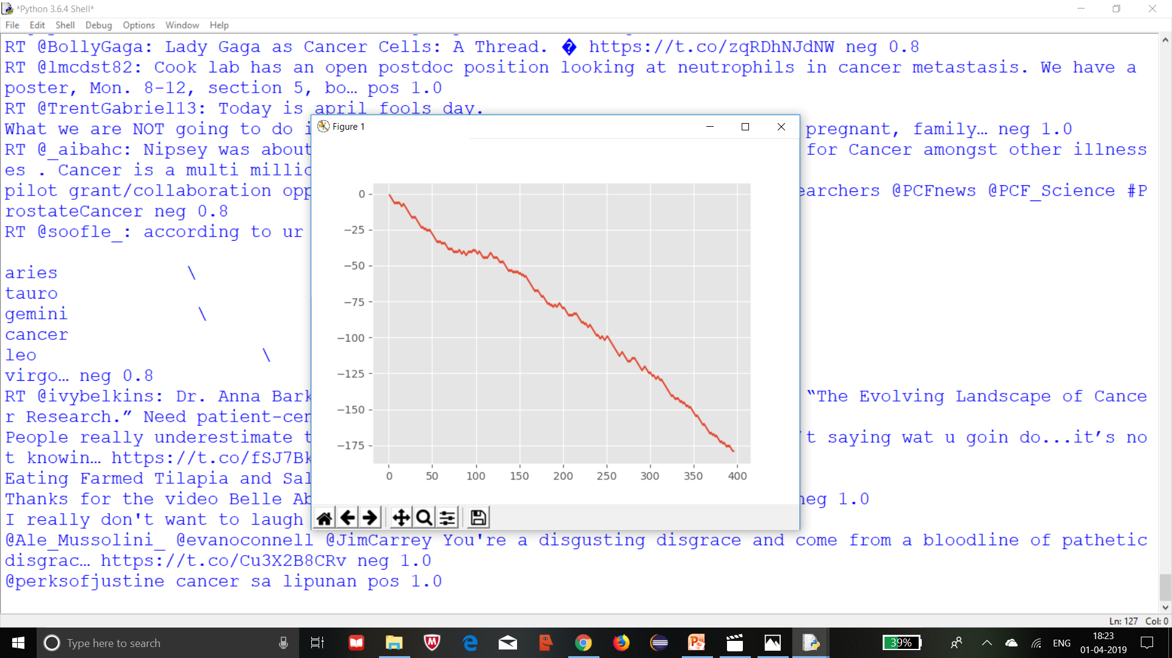

Slide 11
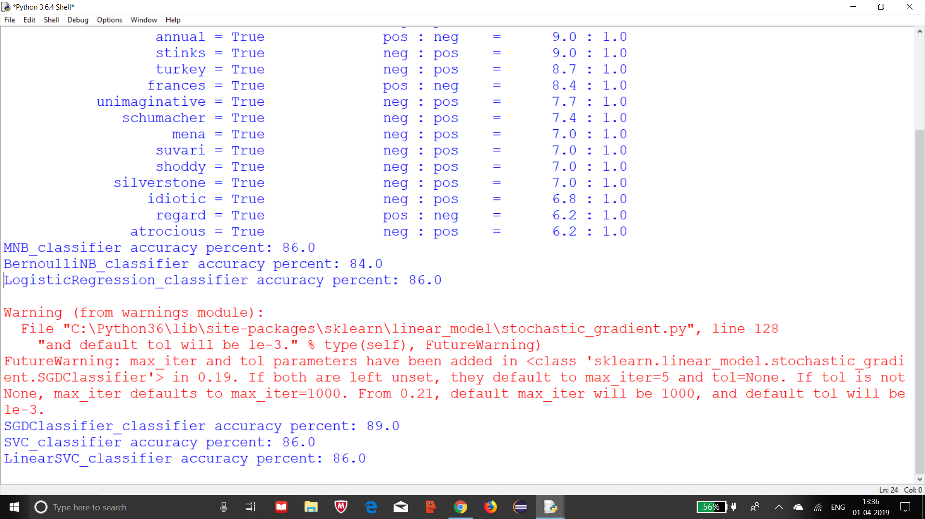

Slide 12
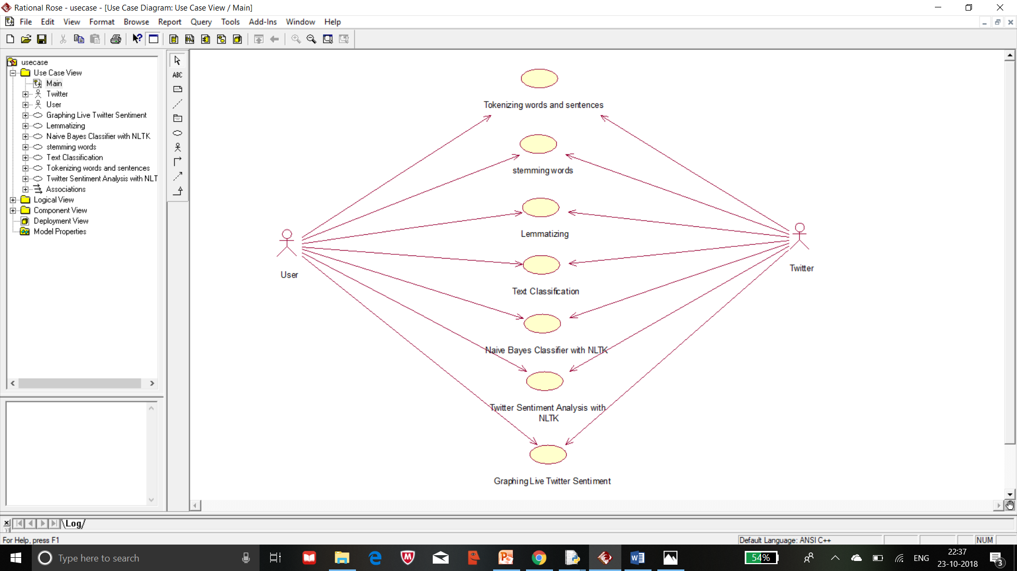
UML Diagrams
Use Case Diagram :

Slide 13
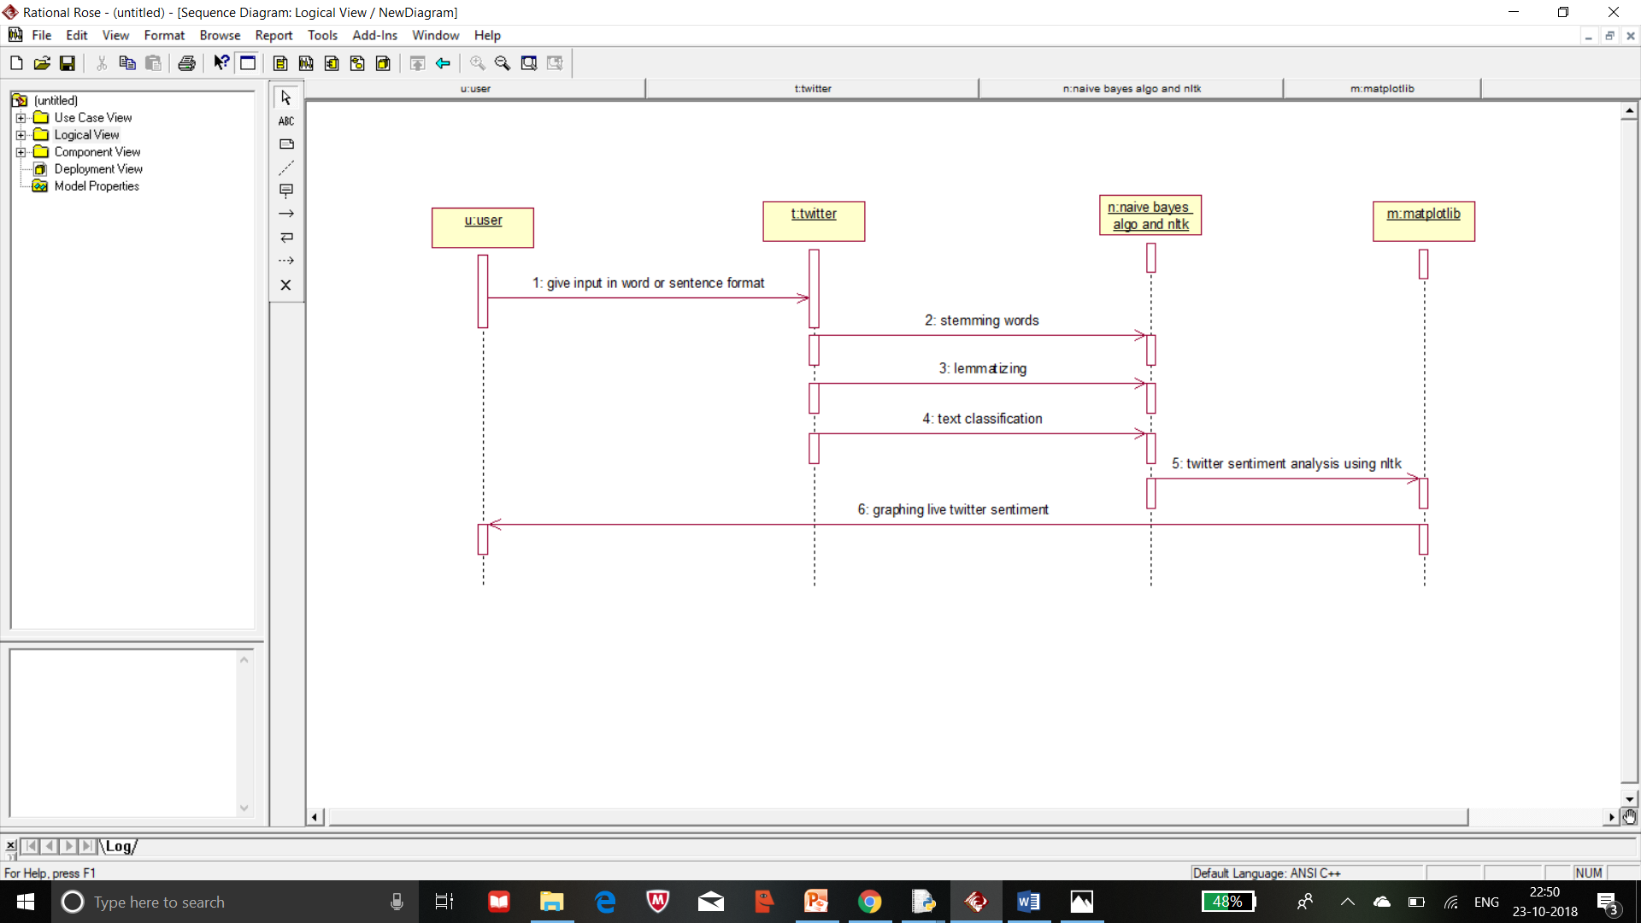
Sequence Diagram :

Slide 14
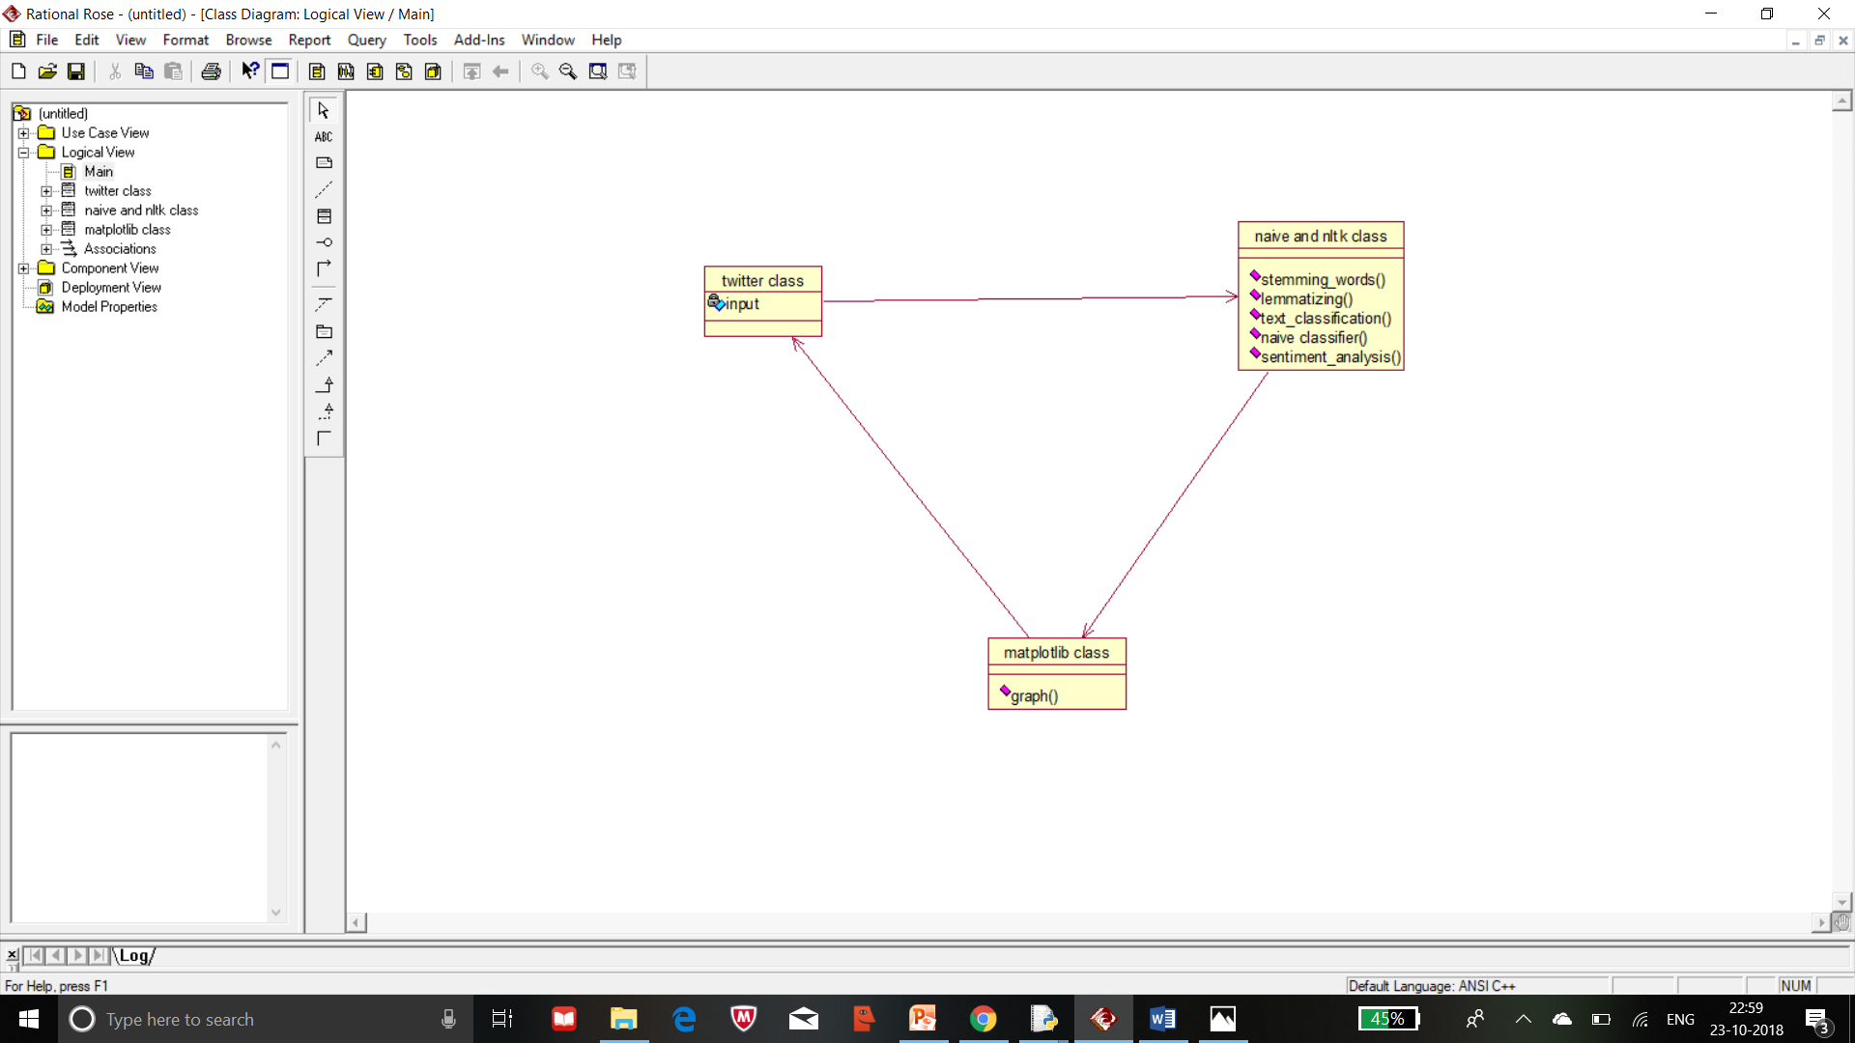
Class Diagram :

Slide 15
Input and Output of the Project
Input given to the Project :The input given in the text format(either an word or sentence).
Output of the Project :After the sentiment analysis is done on the data which was generated by the twitter related to the input which was given to the project then the data will be represented in the graphical form using matplotlib and we get the accuracy percentage of the classifiers.

Slide 16
Conclusion
Multiple methods are used for sentiment analysis of tweets in the health care setting. These range from self-produced basic categorizations to more complex and expensive commercial software. The open source and commercial methods are developed on product reviews and generic social media messages. None of these methods have been extensively tested against a corpus of health care messages to check their accuracy. This study suggests that there is a need for an accurate and tested tool for sentiment analysis of tweets trained using a health care setting–specific corpus of manually annotated tweets first.

Slide 17
References
Ji Xiang, Soon Ae Chun, James Geller, "Monitoring Public Health Concerns Using Twitter Sentiment Classifications", Healthcare Informatics (ICHI) 2013 IEEE International Conference, pp. 335-344, 2013.
Bill Hamilton, "Big Data is the Future of Healthcare", Cognizant 20-20 Insights, September 2012.
M. Cottle, W. Hoover, S. Kanwal, M. Kohn, T. Strome, N.W. Treister, "Transforming Health Care Through Big Data", Institute for Health Technology Transformation(IHTT), 2013.
Skuza Michal, Andrzej Romanowski, "Sentiment analysis of Twitter data within big data distributed environment for stock prediction", Computer Science and Information Systems (FedCSIS) 2015 Federated Conference, 2015.
Lima Ana CES, Leandro N. de Castro, "Automatic sentiment analysis of Twitter messages", Computational Aspects of Social Networks (CASoN) 2012 Fourth International Conference, pp. 52-57, 2012.

Slide 18


Slide 19


